Slide 1
Welcome to Year 4! Nightingales: Mrs Thorpe and Mrs Chivers TAs: Mrs King, Mrs Wheeler Swifts: Miss Lang TAs: Mrs Pruden, Mrs Lee, Ms Vyse, Mrs Papala PPA cover: Mr Mitchell (Premier Sports) and Mrs Khan

Slide 2
A Typical day
Time | Lesson
8.45-9.10 | Registration and morning work (please arrive as close to 8.45 as possible)
9.10-9.30 | Spelling/handwriting/whole class reading
9.30-10.30 | English
10.30-10.50 | Individual and group reading
10.50-11.10 | Playtime
11.10-12.15 | Maths
12.15-1.15 | Lunch time
1.15-2.50 | Topic/Art/ Science/PSHE/ PE/RE/French/Music
2.50-3.15 | Story time/Assembly
3.20 | Home time

Slide 3
English
Grammar
Engaging the reader by developing a range of sentence structures and a wider vocabulary
Accurate punctuation including direct speech
Organising text into paragraphs
Spellings
Continuing to develop phonic knowledge where appropriate
Looking at different ways of spelling the same sound
Homophones and near-homophones
Developing knowledge of prefixes and suffixes
Possessive apostrophes
Handwriting
Cursive letter join, finger spaces
Children will be writing in pencil in all subjects

Slide 4
Reading
Developing positive attitudes to reading and an understanding of what they read.
Read as much as possible and in many different ways! Donations of children’s comics, magazines and newspapers to enhance class libraries greatly appreciated!
Discussing the author’s words and phrases that capture the reader’s interest and imagination.
Learning to “read between the lines”, i.e. What does the author show us rather than tell us?
Volunteers welcomed for running the class sessions in the library and hearing readers.
Parents looking for ideas of books their children might enjoy should visit www.booktrust.org.uk

Slide 5
Reading opportunities include:
Listening to the class story
Whole class and group guided reading
Daily independent reading and follow up quizzes (school banded or home book)
1 to 1 reading as required
Visits to the school library

Slide 6
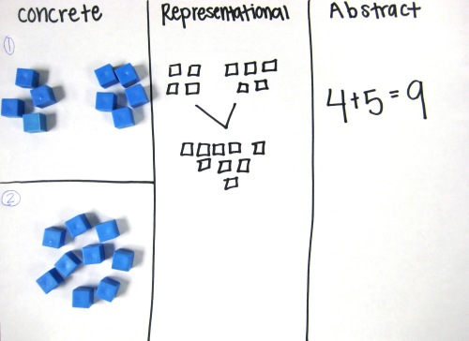

Slide 7
Multiplication Tables Check June 2022
Online test taken by all year 4s across the country
25 questions on the tables 2-12
6 seconds to answer each question

Slide 8
Times tables

Slide 9
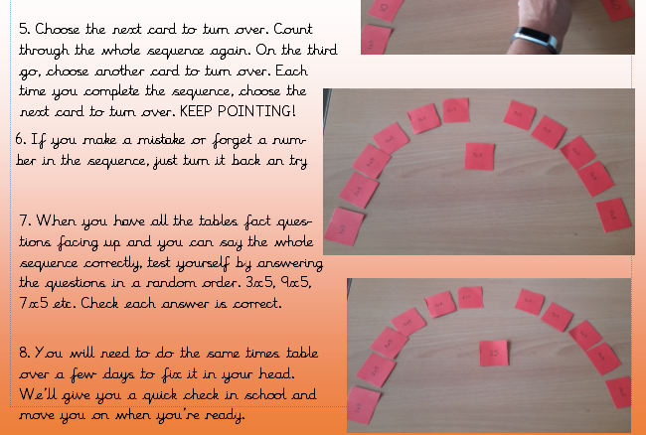

Slide 10
Topic
Science
Ancient Maya
AUTUMN
Electricity
States of Matter
Anglo Saxons
SPRING
Growing living things and dangers to living things
Ancient Egyptians
SUMMER
Sound
Animals including Humans

Slide 11
Art and D&T/ PSHE/French/Computing/RE/Music
Mayan masks, Bayeux tapestry, cooking
PSHE: Myself and my relationships; Rights, rules and responsibilities; Diversity and communities; Drug Education; Personal safety; SRE
French: celebrations, describing pictures, family members, describing appearances
Computing: online safety, coding, word processing
RE: Christianity and Islam
Music: recorders, glockenspiel, singing

Slide 12
P.E
Our PE days are Mondays and Tuesdays (Monday class teacher, Tuesday Premier Sport)
One indoor session, one outdoor session
Children should come to school in their PE kit on those days (no branded tops or football shirts)
Long hair must be tied back
No jewellery, including necklaces, watches and bracelets
Earrings must be removed

Slide 13
Home Learning
Read a wide range of texts and discuss them
Practise times tables
Spelling practice (set on Fridays)
Weekly Mathletics (set on Fridays)
Topic menu tasks x 3
NB where tasks are online, please be aware of what your child is doing and ask us for advice on how best to protect your child. For example, adding parental controls in settings.

