Slide 1
Welcome to Year 5

Slide 2
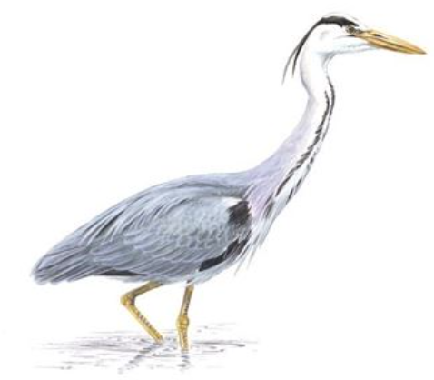
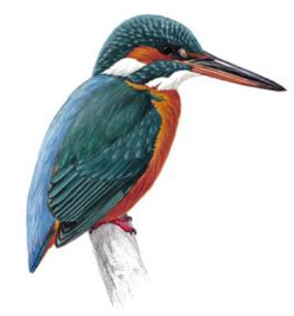
Herons Team
Class teachers:
Mr Gilmore: Monday, Tuesday, Wednesday, Friday
Mrs Rix: Thursday
Teaching Assistants: Mrs Pacey, Mrs Johnson
Kingfishers Team
Class teachers:
Mr White: Monday, Tuesday, Wednesday, Thursday
Friday: Mrs Collins
Teaching Assistants: Mrs Percival, Mrs Pacey, Mrs Wheeler, Mrs Foster

Slide 3
A Typical Day
Time | Lesson
8.45 – 8.55 | Children come in/Register and Morning Activity
8.55 – 10.30 | English
10.30 – 10.50 | Assembly
10.50 – 11.10 | Break
11.10 – 12.15 | Maths
12.15 – 1.15 | Lunch
1.15 – 3.20 | Science/Topic/Music/Computing/PE/French/RE/ Art/DT/PSHE

Slide 4
PE
Our PE days are TUESDAYS (class teacher) and THURSDAYS (Premier Sport)
PE kit to be worn to school for whole day.
Tuesdays – outdoor; Thursdays – indoor/outdoor
Outdoor kits must include suitable outdoor shoes that children can get wet and run safely in e.g. trainers. They also need their legs covered with something they can move easily in e.g. leggings or jogging bottoms (school colours, please). School sweatshirts may be worn.
Earrings should not be worn on PE days unless children can remove them.
Long hair should be tied back with a band.

Slide 6
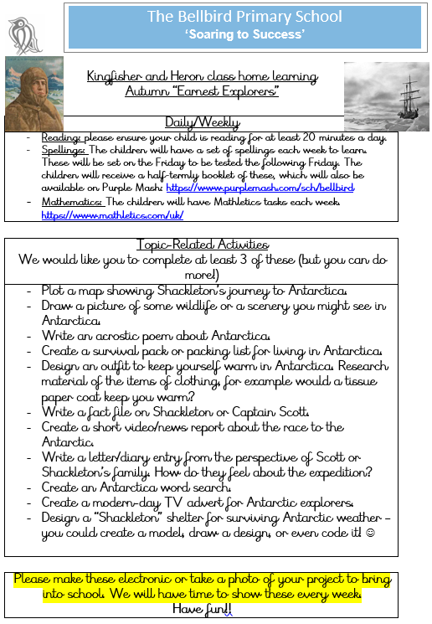

Slide 7
Reading:
We would love to have parent readers in school – do stay behind if you’d like to volunteer!
We need a librarian for each class – do stay behind if you’d like to volunteer!
If you need help finding appropriate books, please do talk to us or use the “Bookfinder” on www.booktrust.org.uk .
https://www.booktrust.org.uk/books-and-reading/bookfinder/

Slide 8
Thank You
Thank you for attending and we look forward to getting to know you all!

