Slide 1
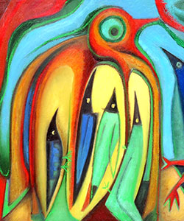
Norfolk Lakes
Year 6 Residential
8th – 10th July

Slide 2
Staff attending:
Mrs. Dobson
Miss Abraham
Mrs. Pentney
Mrs. Stock
Mrs. Wheeler
Children will be split into 4 groups. Each group will have leader/s from Norfolk Lakes and a member of Bellbird staff.

Slide 3
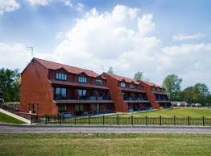
Accommodation
Children will be in a residential block (single-sex rooms) Between 4-6 to a room.
Children must bring a sleeping bag, pillow and pillowcase.

Slide 4
Activities
The children will do:
Aero ball
Blind Trail
Canoe / Kayaking
Obstacle course
Climbing
Campfire
Scavenger Hunt
Archery

Slide 5
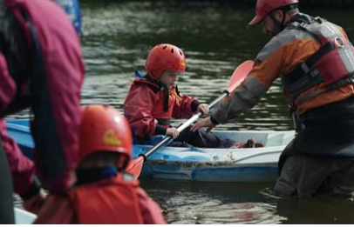
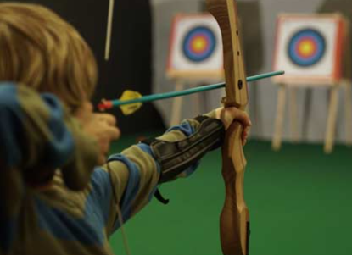
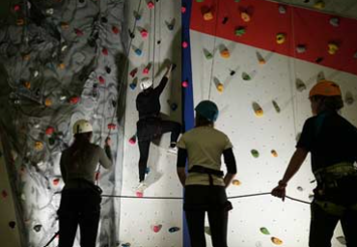

Slide 6
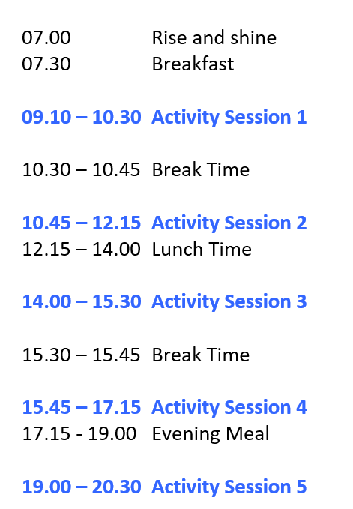
Itinerary
8th July – children arrive at school at normal time. They will need a packed lunch which they will eat before we get the coach. Arrive 2.30pm - They will do session 4 and 5.
9th July – Full day
10th July – Activities 1 and 2 then depart after lunch about 1.30pm
so we should be home for normal pick up time

Slide 7
Food
“We provide your children with three good hot meals each day. A delicious breakfast, nutritious cooked lunch and filling evening dinner are all cooked by our chefs to a high standard.”
Please complete the dietary form and return asap.
Make sure you inform us of any allergies.

Slide 8
Medicines
Everyone MUST complete the medical form and return asap.
Any medication, including travel sickness medication, must be in a named bag and given to class teachers on the Monday morning. We will take the inhalers that the children have already got in school with us too.

Slide 9
Homesickness
No phones. We will have all numbers and can contact parents if needed.
A teddy can provide comfort.
Groupings carefully considered to help support children’s wellbeing.

Slide 10
Kit list
Please check kit list carefully for more details.
Key items to note:
Knee-length shorts only. Leggings/jogging bottoms are ideal
Tops that cover shoulders.
Sun cream/hats/sunglasses
old trainers that can get wet/ruined
second pair of trainers
hair ties
long sleeved clothing
wet weather clothing/waterproof coat
Notes:
Kit list has already been sent out. Please let us know if you need another copy

Slide 11
Other items:
No razors. No food. No spray deodorants/aerosols
£5 to purchase items from tuck shop. This should be in a named purse/envelope and given to class teachers for security
Small game / card game /book
No smart watches please
Plastic bags to put any wet clothes in

Slide 12
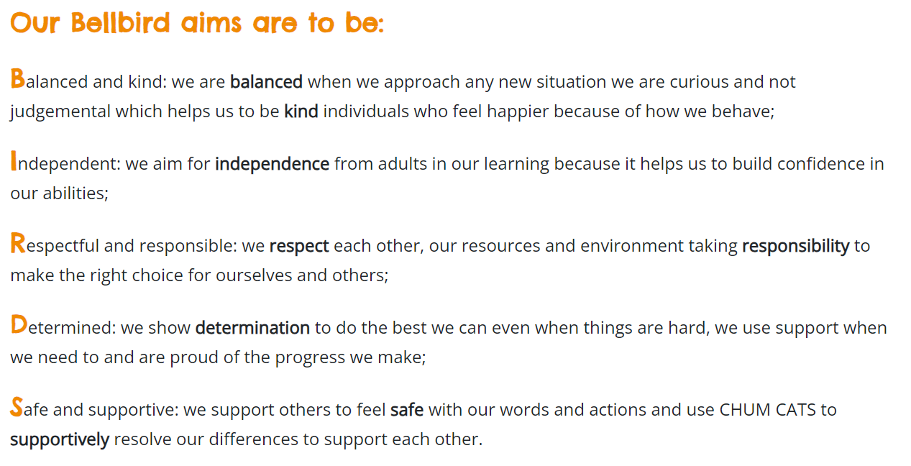
Behaviour Expectations

Slide 13
Top tips from another local school
Children to practice unfolding and folding up sleeping bags
Children to pack own bags if possible or give them a list of their belongings
2 towels are a good idea– one for water activities and another for washing.

Slide 14
Any questions?

