Slide 1
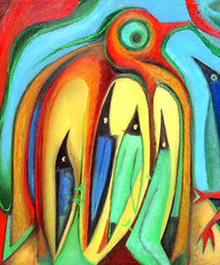
PGL
Year 6 Residential
2nd-4th June

Slide 2
Staff attending:
Mrs. Dobson
Miss Abraham
Mrs. Stock
Mrs. King
Mr. Puxley
Mrs. Collins
Children will be split into 6 groups. Each group will have leader/s from PGL and a member of Bellbird staff.

Slide 3
Itinerary
2nd June– children arrive at school at normal time. They will need a packed lunch to have when they arrive at PGL. Activities in the afternoon.
3rd June– Full day
4th June – Activities in morning and then depart after lunch and will return to school around 4pm.
Exact time TBC

Slide 4

more information from website

Slide 5
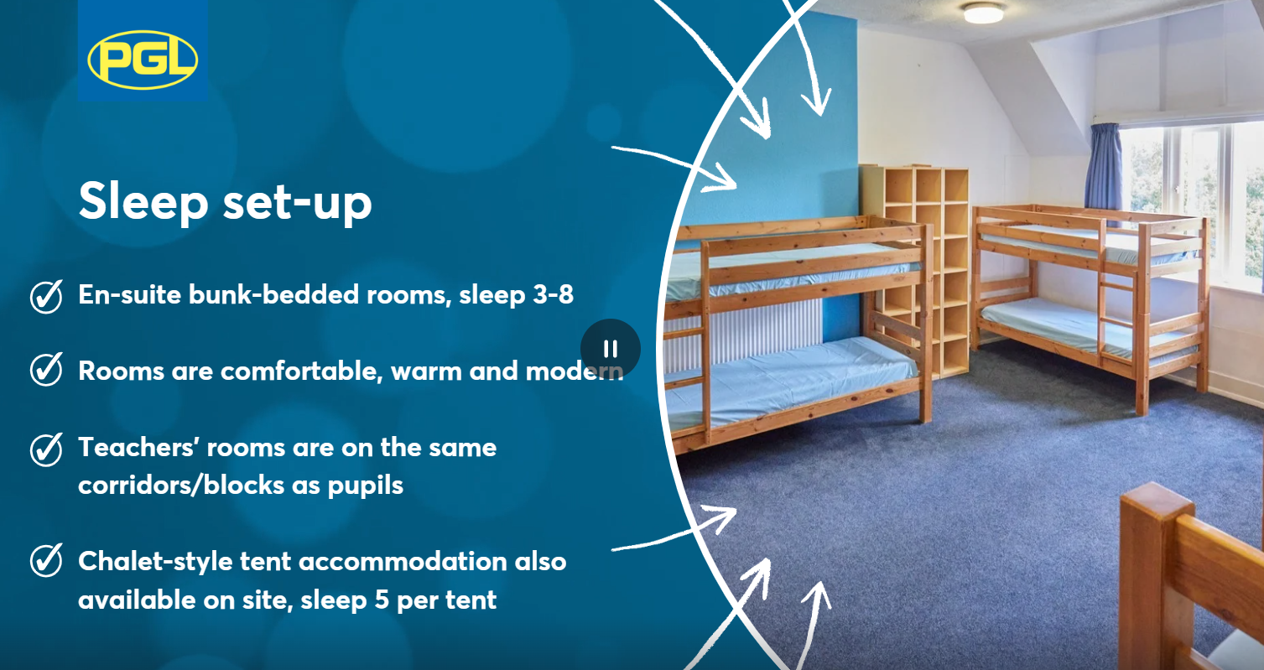
Accommodation
Children will be in a residential block (single-sex rooms) Between 4-6 to a room.
Children must bring a sleeping bag, pillow and pillowcase.

Slide 6
Medicines
If your child needs to take medicine you MUST complete the medical form – these will be sent out nearer the time.
Any medication, including travel sickness medication, must be in a named bag and given to class teachers on the Monday morning. We will take the inhalers that the children have already got in school with us too.

Slide 7
Homesickness
No phones. We will have all numbers and can contact parents if needed.
A teddy can provide comfort.
Groupings carefully considered to help support children’s wellbeing.

Slide 8
Kit list
Please check kit list carefully for more details.
Key items to note:
Knee-length shorts only. Leggings/jogging bottoms are ideal
Tops that cover shoulders.
Sun cream/hats/sunglasses
old trainers that can get wet/ruined
second pair of trainers
hair ties
long sleeved clothing
wet weather clothing/waterproof coat
Insect repellent and bite cream

Slide 9
Other items:
No razors. No food. No spray deodorants/aerosols
£10 max to purchase a souvenir. This should be in a named purse/envelope and given to class teachers for security
Small game / card game /book
No smart watches please
Plastic bags to put any wet clothes in

Slide 10
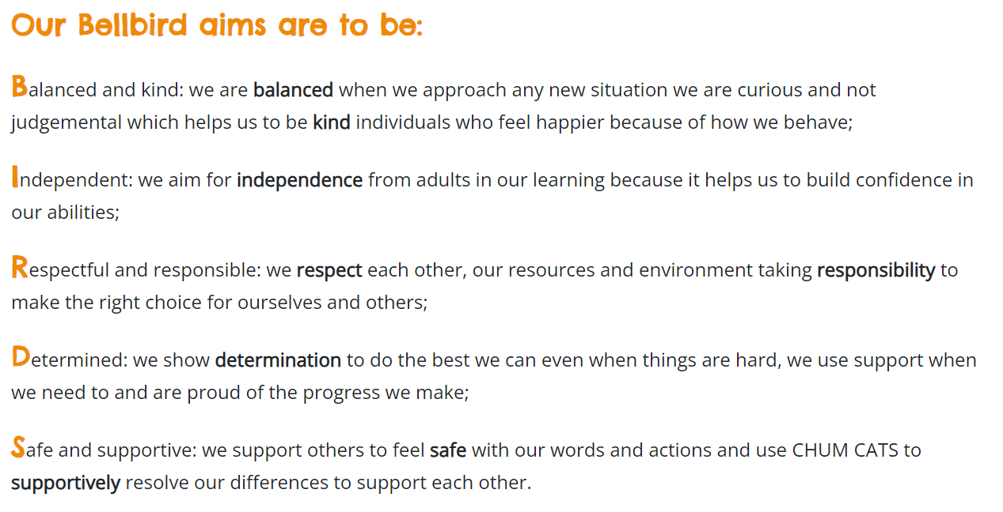
Behaviour Expectations
Notes:
We expect the same rules and levels of respect to be followed as if we were in school

Slide 11
Any questions?

