Slide 1


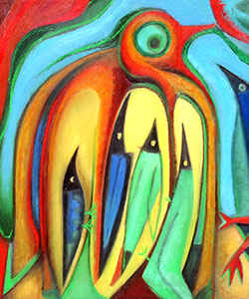
Welcome to Year 3- Please sign in using the sheets on the desks.

Slide 2
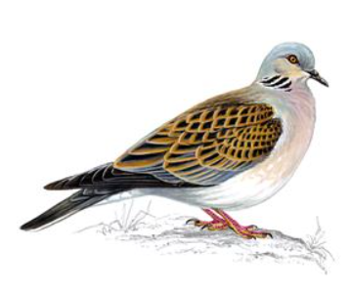

Doves Team
Class teacher:
Mr White (Mon-Thurs)
Mrs Collins (Fri)
Teaching Assistants:
Mrs Pacey, Mrs Papala, Mrs Simons, Mrs McLaren
Swallows Team
Class teacher:
Mrs Rickcord (Alternate Mons; Tues to Fri am)
Mrs Kent (alternate Mons) Miss Vyse (alternate Fri pm)
Teaching Assistant:
Mrs Dawson, Miss Vyse, Miss Foster

Slide 3
A Typical Day
Time | Lesson
8.45 – 9.10 | Children come in/Register and Morning Activity
9.10 – 9.45 | Reading
9.45 – 10.00 | Spelling / handwriting
10.00-11.00 | English
11.00-11.15 | Break
11.15 – 12.15 | Maths
12.15-1.15 | Lunch
1.15 – 2.55 | Science/History/Geography/Music/Computing/PE/French/RE/ Art/DT/PSHE
2.55 – 3.20 | Assembly/Story Time

Slide 4
What’s different in Year 3?
longer morning
later lunch
different playground (and climbing frame)
snack time
3:20pm end time
afternoon break isn’t statutory
swimming TBC

Slide 5
PE
Our PE days are TUESDAYS (Mr Pauley) and FRIDAYS (Class Teacher)
PE kit to be worn to school for whole day.
Tuesdays – outdoors; Fridays – indoors (these may change half termly; we will inform you.)
Outdoor kits must include suitable outdoor shoes that children can get wet and run safely in e.g. trainers. They also need their legs covered with something they can move easily in e.g. leggings or jogging bottoms (school colours, please). RAINCOATS PLEASE!
School sweatshirts may be worn.
Earrings should not be worn on PE days unless children can remove them.
Long hair should be tied back with a band.

Slide 6
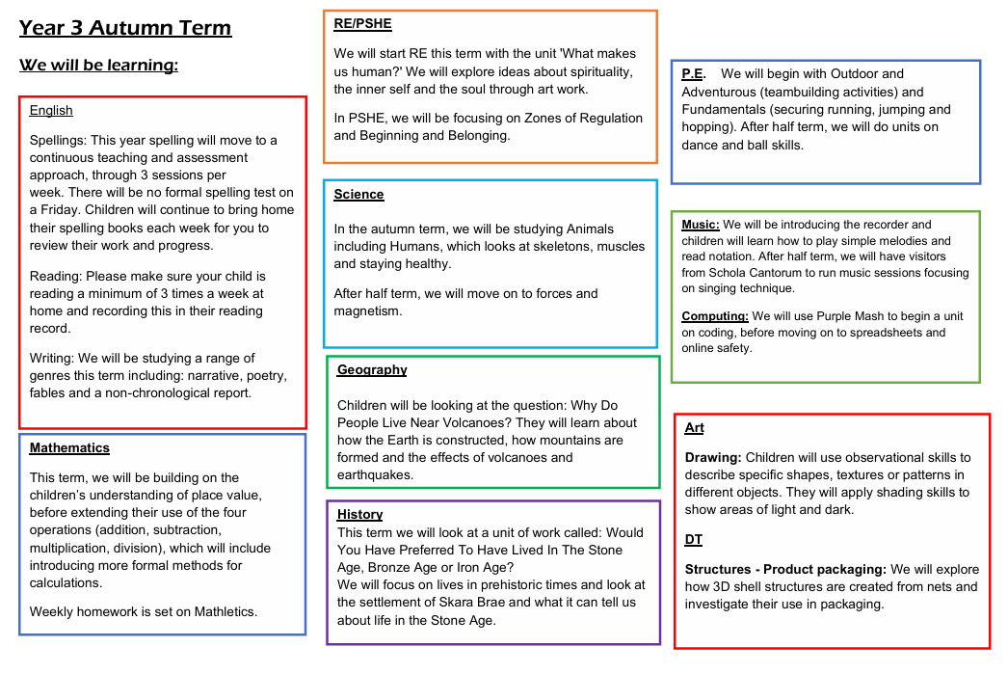
Notes:
NEEDS CHANGING!

Slide 7
Reading:
We would love to have parent readers in school – do stay if you’d like to volunteer!
We need a librarian for each class – do stay behind if you’d like to volunteer!
Please support your child by recording when you read with them in their Reading Record.
Star Reader (later in the year)
Year 3 is a key year for beginning the transition to becoming an independent reader – but PLEASE keep reading to them and with them.
If you need help finding appropriate books, please do talk to us or use the “Bookfinder” on www.booktrust.org.uk .
https://www.booktrust.org.uk/books-and-reading/bookfinder/

Slide 8
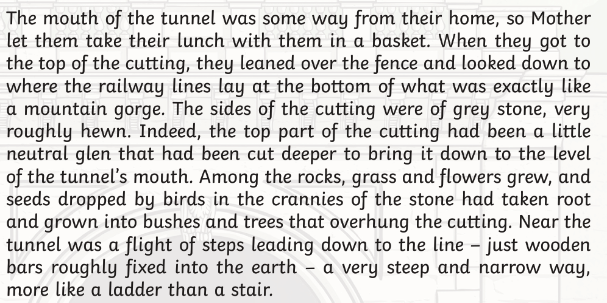
Reading:

Slide 9
Spelling and Times tables:
Spellings will be taught and continuously assessed throughout the week. There will no longer be a spelling test on a Friday.
Parents will still be able to look at their spelling books when they come home on a Friday to see their children’s progress with spelling.
Children will have fortnightly times tables test this year and any times tables that they need to work on will be recorded in the back on their spelling book that will come home each week.

Slide 10
Maths support:
Mathletics:
(still to be set up – more information will follow when ready)
We will set two or three tasks per week linked to the current learning within school
Children also have available Times Table Rockstars and Purple Mash activities

Slide 11
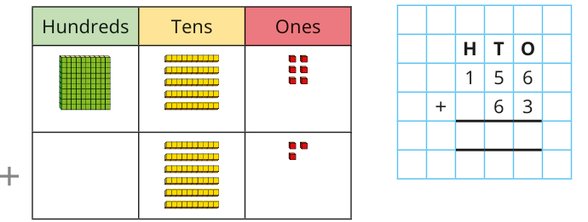
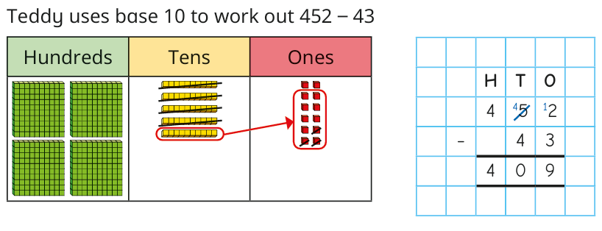
Maths support:

Slide 12
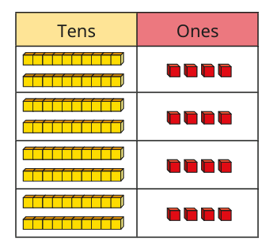
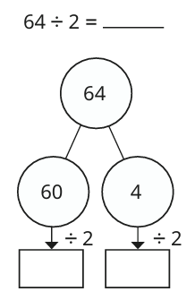
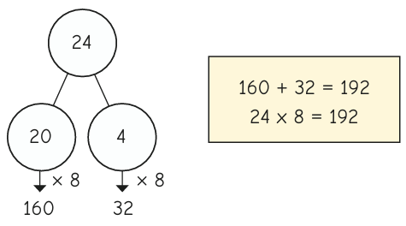
Maths support:

Slide 13
Trips and visitors:
We are hoping to run trips to Colchester Castle and Cambridge.
Librarians/parent readers
Subject specific visits

Slide 14

Who we are
FABS (Friends At Bellbird School) is the PTA at The Bellbird, and is run by a small number of dedicated parent volunteers.
What we do
Last year we have raised over £9,500 from our events, including the Christmas and Summer Fairs, school discos and quiz nights, and we donated over £14,500 to fund the purchase of 32 new Chromebooks to support the delivery of the IT curriculum, to provide swimming lessons, a whole school pantomime and paid for a re-stock of the school library and new star reader books.
We need your help!
We are always looking for new parents who want to get involved, please do get in touch on bellbirdpta@gmail.com.

Slide 15
Any questions?
Notes:
NEEDS CHANGING?

Slide 16
Thank You
Thank you for attending and we look forward to getting to know you all!

