Slide 1
Welcome to Year 4!
Nightingales: Mrs Dervish and Mrs Chivers
TAs: Mrs Wheeler & Miss Neal
Swifts: Miss Smith
TAs: Mrs Stock, Mrs Beckwith and Mrs Taylor
PPA cover: Mr Pauley, Miss Vyse

Slide 2
A Typical day
Time | Lesson
8.45 – 9.10 | Children come in/Register and Morning Activity
9.10 – 9.45 | Reading
9.45 – 10.45 | English
10.45-11.00 | Spelling / handwriting/times tables
11.00-11.15 | Break
11.15 – 12.15 | Maths
12.15-1.15 | Lunch
1.15 – 2.55 | Science/History/Geography/Music/Computing/PE/French/RE/ Art/DT/PSHE
2.55 – 3.20 | Assembly/Story Time

Slide 3
PE
Our PE days are MONDAYS (Class Teacher) and WEDNESDAYS (Mr Pauley)
PE kit to be worn to school for whole day.
Monday – indoors ; Wednesday – outdoor (these may change half termly; we will inform you.)
Outdoor kits must include suitable outdoor shoes that children can get wet and run safely in e.g. trainers. They also need their legs covered with something they can move easily in e.g. leggings or jogging bottoms (school colours, please).
School sweatshirts may be worn.
Earrings should not be worn on PE days unless children can remove them.
Long hair should be tied back with a band.

Slide 4
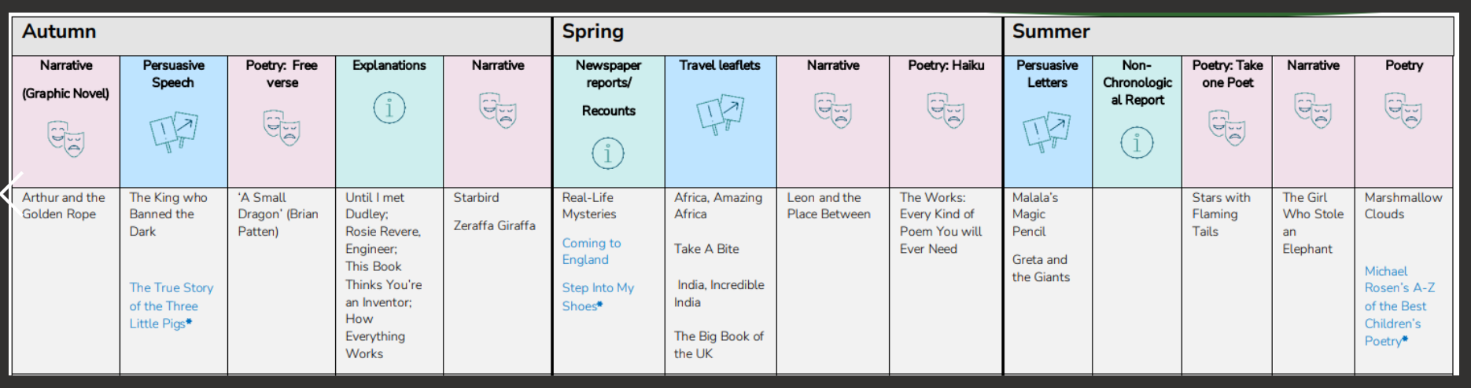
English

Slide 5
English
Grammar
Accurate punctuation, including direct speech
Organising text into paragraphs
Comma use
Apostrophes (possessive and for contraction)
Spellings
Continuing to develop phonic knowledge where appropriate
Looking at different ways of spelling the same sound
Homophones and near-homophones
Developing knowledge of prefixes and suffixes
Forming adverbs
Irregular plurals
Unsounded syllables
Year 3/4 statutory spellings
Handwriting
Cursive letter join, finger spaces

Slide 6
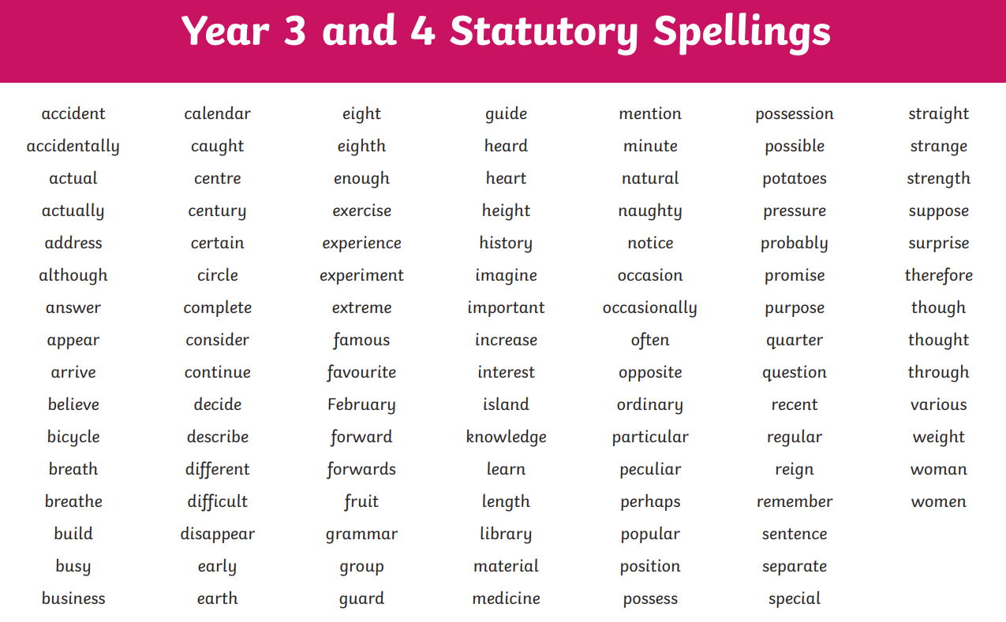

Slide 7
Spelling and Times tables:
Spellings will be taught and continuously assessed throughout the week. There will no longer be a spelling test on a Friday.
Parents will still be able to look at their spelling books when they come home on a Friday to see their children’s progress with spelling.
Children will have fortnightly times tables test this year and any times tables that they need to work on will be recorded in the back on their spelling book that will come home each week.
Weekly Mathletics (set on Fridays)

Slide 8
Reading
Developing positive attitudes to reading and an understanding of what they read.
Read as much as possible and in many different ways! Please encourage them to sign their reading records.
Donations of children’s comics, magazines and newspapers to enhance class libraries greatly appreciated!
Discussing the author’s words and phrases that capture the reader’s interest and imagination.
Learning to “read between the lines”, i.e. what does the author show us rather than tell us?
Volunteers welcomed for running the class sessions in the library and hearing readers.
Parents looking for ideas of books their children might enjoy should visit www.booktrust.org.uk
For developing comprehension skills, parents can visit home.oxfordowl.co.uk

Slide 9
Reading opportunities in school include:
Listening to the class story
Whole class reading
Daily independent reading and follow up quizzes (school banded or home book)
1 to 1 reading as required
Visits to the school library

Slide 10
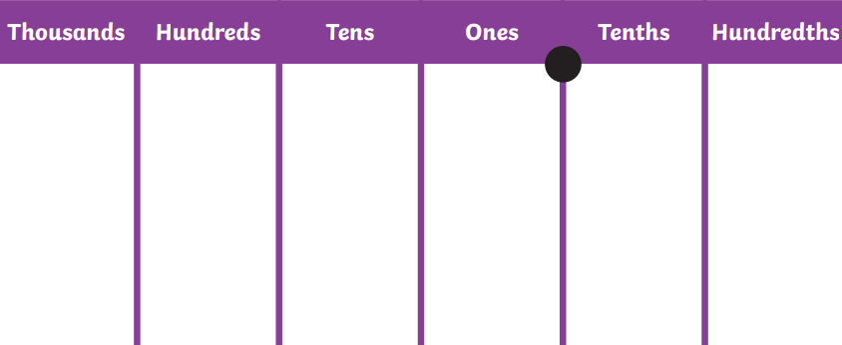
Maths

Slide 11
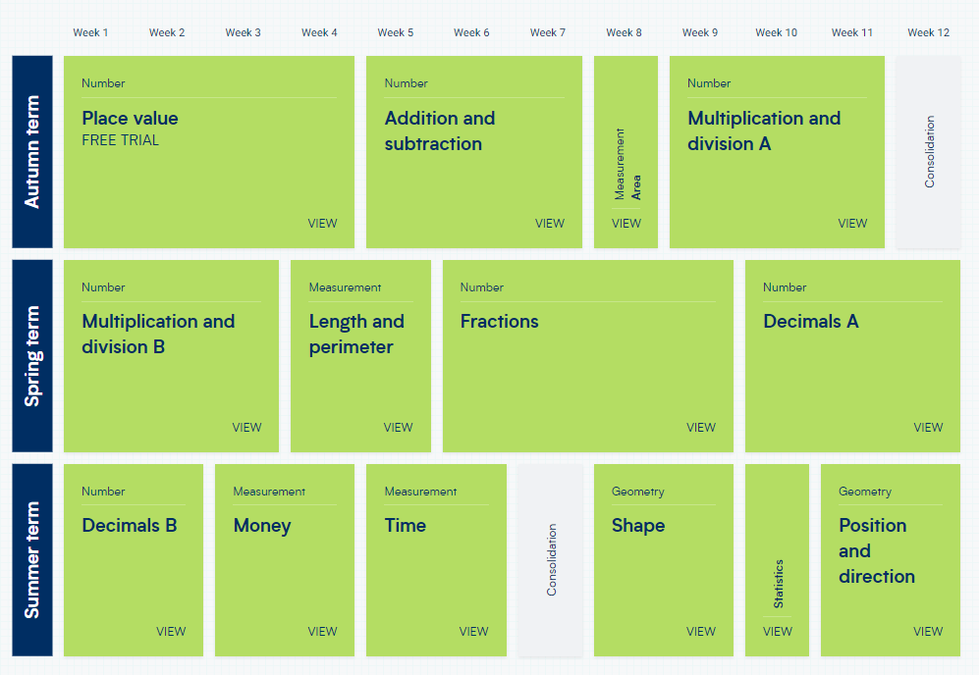
White Rose maths.

Slide 12
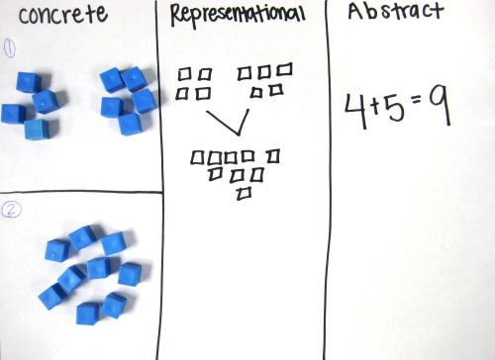

Slide 13
Multiplication Tables Check
June 2027
Online test taken by all year 4s across the country
25 questions on the tables 2-12
6 seconds to answer each question
https://mathsframe.co.uk/en/resources/resource/477
https://www.purplemash.com/#app/games/timestables_assessment
https://ttrockstars.com/
https://www.topmarks.co.uk/maths-games/hit-the-button

Slide 14
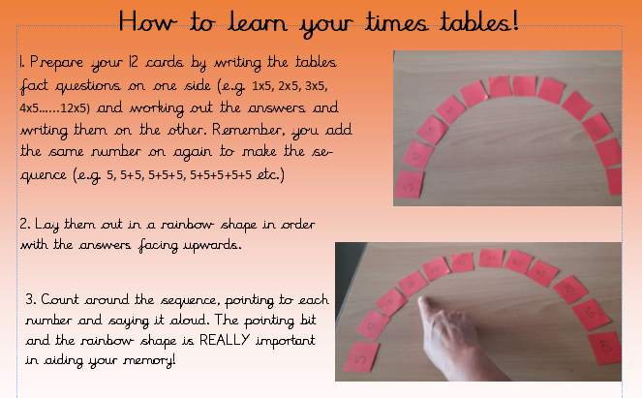
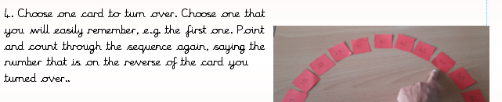

Slide 15
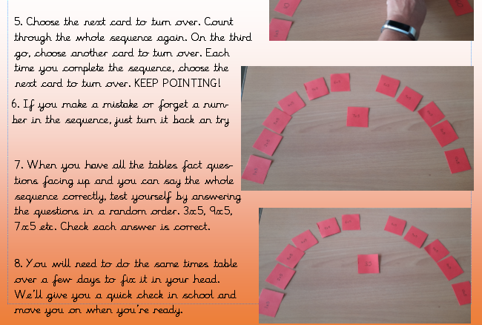

Slide 16
Geography & History
Science
AUTUMN
How children’s lives have changed.
Where does our food come from?
AUTUMN
Digestion
Electricity
SPRING
States of Matter
Sound
SPRING
Anglo Saxons
Rainforests
SUMMER
Classification and changing habitats.
Comparing the properties of liquid
SUMMER
Ancient Maya
Rivers
If you think you would be able to come in to do a class talk linked to any of these areas, please fill in on the sign up sheet.

Slide 17
Art and D&T/ PSHE/French/Computing/RE/Music
Drawing, painting, cooking, mechanisms, electrical systems, craft & design.
PSHE: Citizenship, rights and responsibilities, relationships, emotions, anti-bullying week, diversity, community, healthy and safe lifestyles, SRE
French: I Am Able to, Phonics, Vegetables, Presenting Myself, In the Classroom
Computing: Microsoft Office, Coding with Scratch, online safety, data handling (weather mapping)
RE: Are all religions equal? What makes some scared texts? How important are our beliefs? Who was Jesus really? Why is the Bible the best selling book of all time? Does the language of scripture matter?
Music: Singing in parts: loops and layers, Musical Motifs: Reading the staves, Singing with Schola Cantorum, Music technology: loop based composition.
If you think you would be able to come in to do a class talk linked to any of these areas, please fill in on the sign up sheet.

Slide 18
Assessment
GDS: Working at greater depth within the expected standard for the year group objectives
EXS: Working at the expected standard
WTS: Working towards the expected standard
B: Working below the expected standard
PKS: used to assess all pupils working below the level of the national curriculum but who are engaged in subject-specific learning.

Slide 19
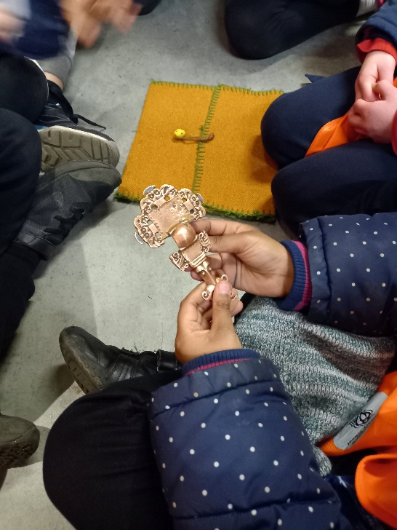

Trips & Visitors
West Stow
Ancient Maya Day
A local trip to be confirmed

Slide 20

Who we are
FABS (Friends At Bellbird School) is the PTA at The Bellbird, and is run by a small number of dedicated parent volunteers.
What we do
Last year we have raised over £9,500 from our events, including the Christmas and Summer Fairs, school discos and quiz nights, and we donated over £14,500 to fund the purchase of 32 new Chromebooks to support the delivery of the IT curriculum, to provide swimming lessons, a whole school pantomime and paid for a re-stock of the school library and new star reader books.
We need your help!
We are always looking for new parents who want to get involved, please do get in touch on bellbirdpta@gmail.com.

