Slide 1

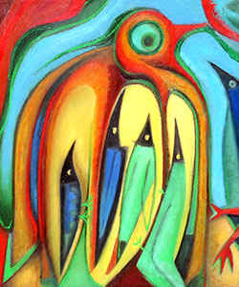
Welcome to Year 1. Please sign in using the sheets on the tables.

Slide 2
M
Meet the team
Sparrows
Mrs Rix and Mrs McLaren
Wagtails
Mrs Booth, Mrs Irwin and Mrs Day
Working across both classes
Mrs Simons, Miss Vyse, Mr Pauley

Slide 3
A Typical Day
Time
Lesson
Time | Subject
8.45 – 9.10am | Registration and early morning work
9.10 – 9.35am | Reading and Phonics
9.35 – 10.45am | English / Mastering Number / Handwriting
10.45 – 11.00am | Snack and playtime
11.00 – 12.00pm | Maths
12.00 – 1.00pm | Lunchtime (KS1 playground)
1.00 – 1.30pm | Science/DT/Art/History/Geography/ Computing/RE/PSHE
1.30 – 2.45pm | Playful learning and playtime
2.45 – 3.15pm | Assembly / Story

Slide 4
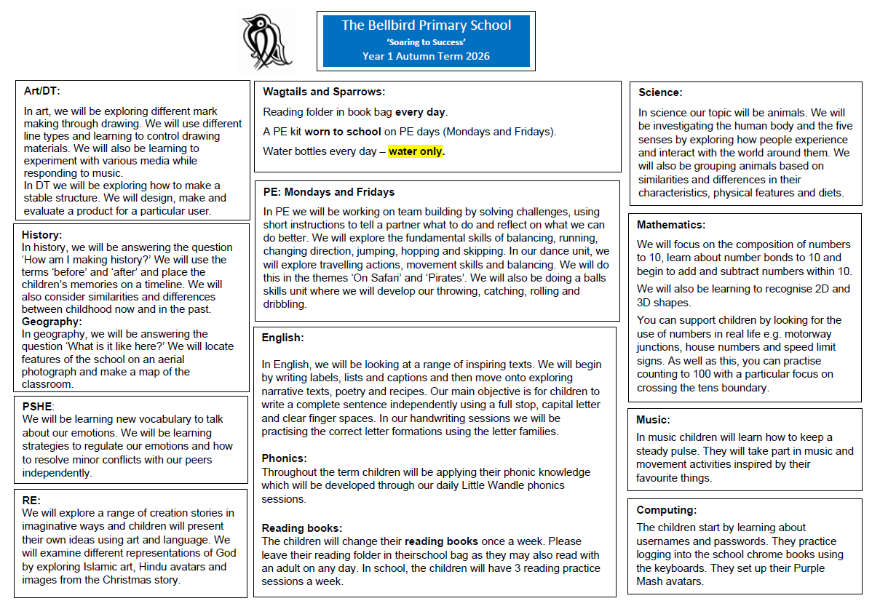

Slide 5
Phonics
Little Wandle (government approved scheme).
We will have daily phonics lessons.
Recap of phase 3 and 4 sounds and then introducing phase 5.
Weekly sheet with phonics learning.
Year 1 statutory phonics assessment in the summer term.
Little Wandle: For parents | Letters and Sounds

Slide 6
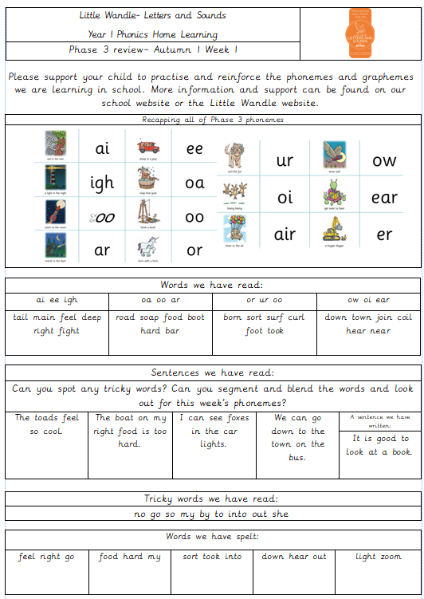

Slide 7
Reading
Little Wandle scheme
3 reading sessions with an adult a week (decoding, prosody, comprehension).
Children will bring home a new decodable reading book each week. They should be reading this fluently. Please support your child by recording when you read with them in their Reading Record.
We would love to have parent readers in school – do stay if you’d like to volunteer!
We need a librarian for each class – do stay behind if you’d like to volunteer!
Year 1 is a key year for embedding phase 5 phonics, decoding and automaticity.

Slide 8
English
We explore a range of text types (stories and non-fiction).
Writing is purposeful with an audience in mind.
Oral rehearsal of sentences is key.
Year 1 – year of the sentence. Capital letters, full stops, finger spaces, application of phonics (still okay to write words phonetically!)
Free writing weekly.
SPELLINGS – We are no longer sending spellings home for a weekly spelling quiz – spellings will be practised whole class on Fridays instead.

Slide 9
Handwriting
Fine motor skills (playdough, threading, sorting small objects, building towers with lego).
Tripod grip
Letter formation – curly caterpillars, zigzag monsters, long ladders, one-armed robots.

Slide 10
Maths
Place value to 10 and addition and subtraction to 10 up to Christmas.
Focus on practical exploration of number.
Addition and subtraction stays within numbers up to 20.
Shape, measure, time.
White Rose Maths: White Rose Education | White Rose Education

Slide 11
PE
Our PE days are MONDAYS and FRIDAYS with Mr Pauley.
Dance, gymnastics, outdoor and adventurous activities, games, throwing and catching skill, athletics.
PE kit to be worn to school for whole day.
Please ensure trainers that the children can run in safely preferably WITHOUT laces. They also need their legs covered with something they can move easily in e.g. leggings or jogging bottoms (school colours, please).
School sweatshirts may be worn.
Earrings should NOT be worn on PE days OR use tape to cover them.
Long hair should be tied back with a band.

Slide 12
Supporting your child at home
Reading - children will bring home a practice book and a sharing book.
Practise books = decodable (they can use their phonics to read the words). They should be reading this fluently!
Sharing books = library book.
Purple Mash (when they have logins, they will be found in the middle of reading records) – platforms for activities and games.
Mathletics (logins will be sent out after Christmas).

Slide 13
Trips and Visitors
Shepreth Wildlife Park – Thursday 26th November
Toy museum and toy making workshop – spring term – date to be confirmed
Local visit – Mill Lane Park
We will need parent helper to accompany us – details will be included in trip letters.
We are always looking for volunteers to give talks or share experiences that are linked to our curriculum.

Slide 14
Key Points
Water bottles in school everyday (water only please).
Reading folder in school every day.
Snack at playtime is provided – snacks from home should be fruit/veg only.
Label everything please!
PE kit to be worn to school Mondays and Fridays.
Please discourage your child from bringing toys into school.

Slide 15
Any questions?

