Slide 1


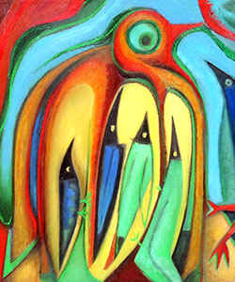
Welcome to Year 5- Please sign in using the sheets on the desks.

Slide 2
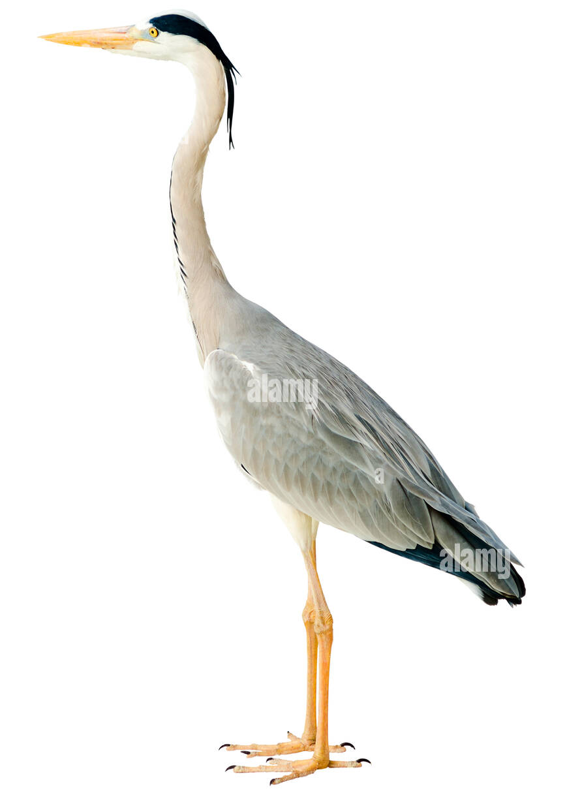
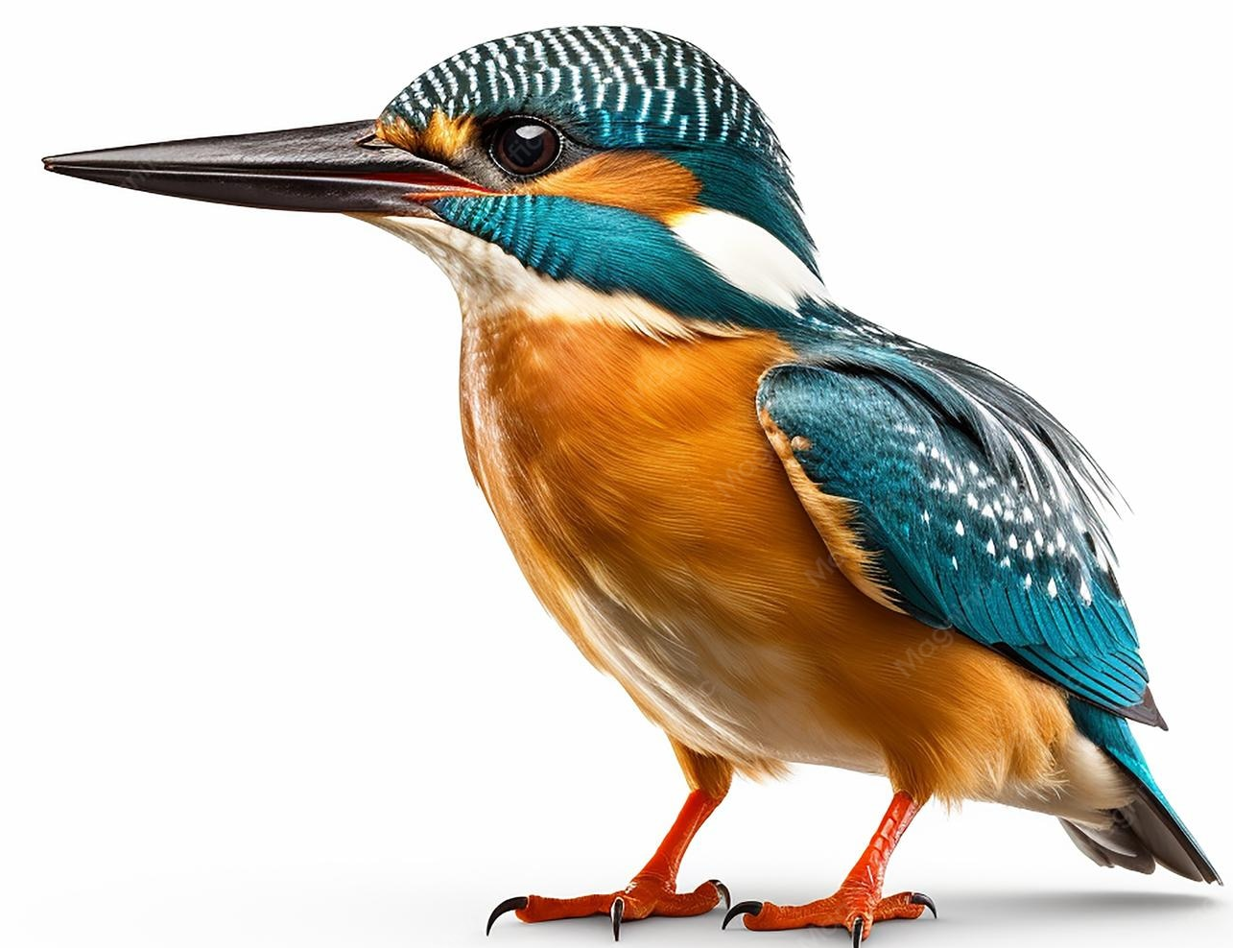
Herons Team
Class teacher:
Miss E. Reece
Teaching Assistants:
Mrs Simons
Mrs Khan
Kingfisher Team
Class teacher:
Mr L. Postgate
Teaching Assistant:
Mrs Lee

Slide 3
A Typical Day
Time | Lesson
8.45 – 9.10 | Children come in/Register and Morning Activity
9.10 – 9.45 | Reading
9.45 – 10.00 | Spelling / handwriting
10.00-11.00 | English
11.00-11.15 | Break
11.15 – 12.15 | Maths
12.15-1.15 | Lunch
1.15 – 2.55 | Science/History/Geography/Music/Computing/PE/French/RE/ Art/DT/PSHE
2.55 – 3.20 | Assembly/Story Time

Slide 4
PE
Our PE days are WEDNESDAYS (Mr Pauley) and THURSDAYS (Class Teacher)
PE kit to be worn to school for whole day.
Wednesdays – outdoor; Thursdays – indoor (these may change half termly; we will inform you.)
Outdoor kits must include suitable outdoor shoes that children can get wet and run safely in e.g. trainers. They also need their legs covered with something they can move easily in e.g. leggings or jogging bottoms (school colours, please).
School sweatshirts may be worn.
Earrings should not be worn on PE days unless children can remove them.
Long hair should be tied back with a band.

Slide 5
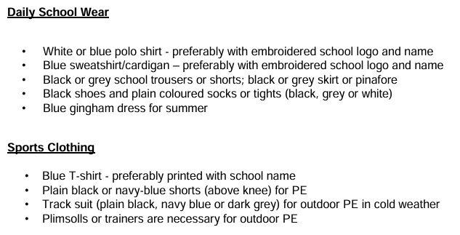
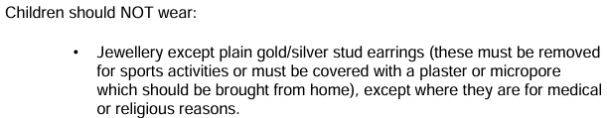

Uniform

Slide 6
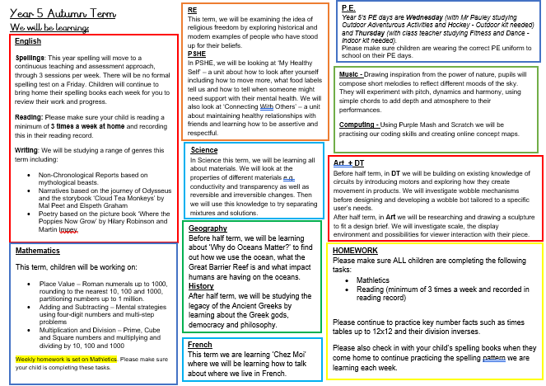
Notes:
NEEDS CHANGING!

Slide 7
Reading:
We would love to have parent readers in school – do stay if you’d like to volunteer!
We need a librarian for each class – do stay behind if you’d like to volunteer!
Please support your child by recording when you read with them in their Reading Record.
Star Reader
If you need help finding appropriate books, please do talk to us or use the “Bookfinder” on www.booktrust.org.uk .
https://www.booktrust.org.uk/books-and-reading/bookfinder/

Slide 8
Spelling and Times tables:
Spellings will be taught and continuously assessed throughout the week. There will no longer be a spelling test on a Friday.
Parents will still be able to look at their spelling books when they come home on a Friday to see their children’s progress with spelling.
Children will have fortnightly times tables test this year and any times tables that they need to work on will be recorded in the back on their spelling book that will come home each week.

Slide 9
Maths support:
Mathletics:
(still to be set up – more information will follow when ready)
We will set two or three tasks per week linked to the current learning within school
Children also have available Times Table Rockstars and Purple Mash activities

Slide 10
Trips and visitors:
Fitzwilliam Museum:
Tuesday 15th December – Looking at Ancient Greek artefacts and how archaeologists use them to find out what Ancient Greek life was like.

Slide 11

Who we are
FABS (Friends At Bellbird School) is the PTA at The Bellbird, and is run by a small number of dedicated parent volunteers.
What we do
Last year we have raised over £9,500 from our events, including the Christmas and Summer Fairs, school discos and quiz nights, and we donated over £14,500 to fund the purchase of 32 new Chromebooks to support the delivery of the IT curriculum, to provide swimming lessons, a whole school pantomime and paid for a re-stock of the school library and new star reader books.
We need your help!
We are always looking for new parents who want to get involved, please do get in touch on bellbirdpta@gmail.com.

Slide 12
Any questions?
Notes:
NEEDS CHANGING?

Slide 13
Thank You
Thank you for attending and we look forward to getting to know you all!

