Slide 1


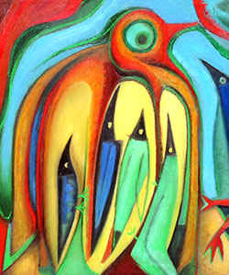
Welcome to Year 2!
Please sign in using the sheets on the desks.

Slide 2
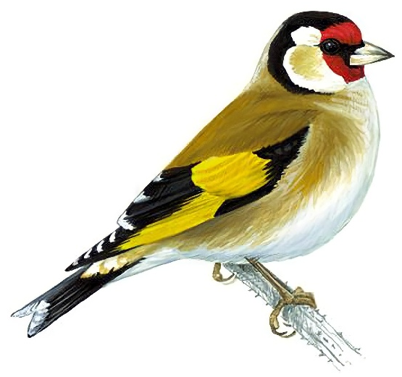
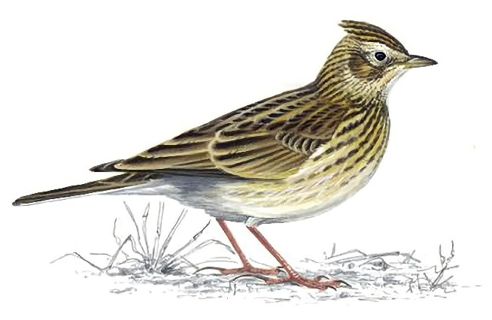
Goldfinches Team
Class teachers: Mrs Hines and Miss Lang
Teaching Assistants: Mrs Leech, Mrs King (1:1), Mrs Taylor (1:1),
Miss Foster (1:1), Mrs Khan (1:1)
Skylarks Team
Class teacher: Miss Lettington
Teaching Assistants: Mrs Percival, Mrs Beckwith (1:1), Mrs Pacey (1:1)
PPA cover (both classes): Mrs Irwin and Mr Pauley

Slide 3
A Typical Day
Time | Lesson
8.45 – 9.10 | Children come in/register/morning activity Please be prompt!
9.10 – 9.30 | Whole school reading
9.30 – 9.50 | Spelling
9.50-10.30 | English
10.30-10.45 | Snack and story
10.45-11.00 | Break
11.00 – 11.50 | Maths
12.00-1.00 | Lunch
1.00 – 2.55 | Science/History/Geography/Music/Computing/PE/French/RE/ Art/DT/PSHE
2.00-2.10 | Break
2.55 – 3.20 | Assembly/Story Time

Slide 4
What’s different in Year 2?
Increased independence. Children should organise their reading folders and reading record books, water and water bottles.
Children should be able to fasten their own clothing. (Velcro shoes are advised. Please label all clothes.)
Children should be able to peel bananas and satsumas.
Desks! No continuous provision.
Spelling rules.
Handwriting.

Slide 5
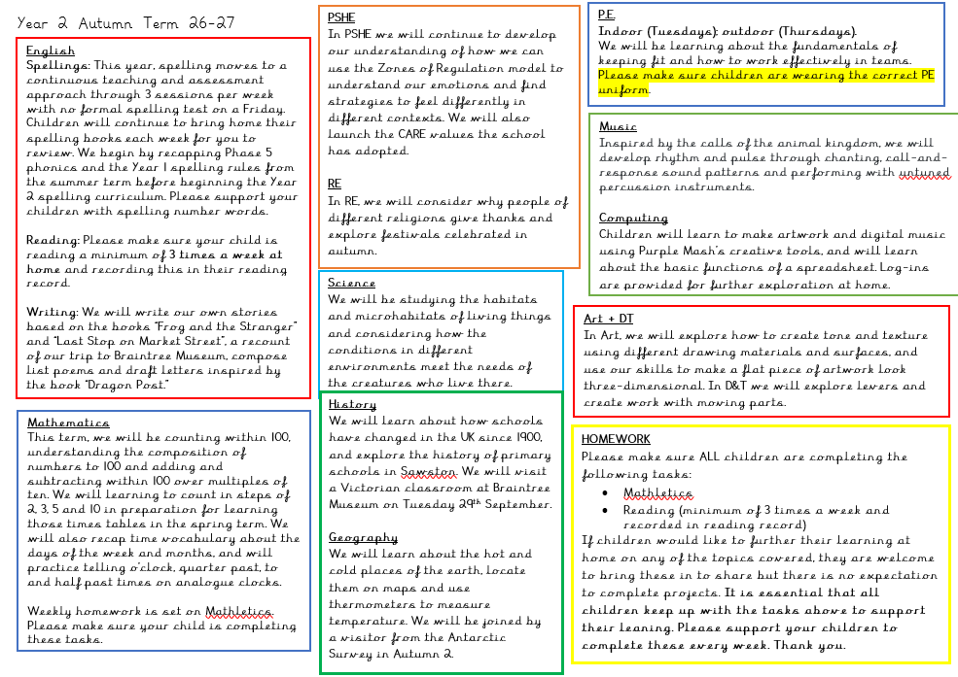
Year 2 Learning overview

Slide 6
Equipment into School
If your child needs to bring in their own snack, it must be a piece of fruit or vegetable. Please only send in grapes if they have been cut up.
No precious items or toys in school (key rings, toys, Pokemon cards etc.).
No stationery needs to be sent in. We will provide all of this for the children.
Named water bottles need to be sent in and taken home each day.
Notes:
GH

Slide 7
PE
Our PE days are TUESDAYS (class teacher-indoor) and THURSDAYS (Mr Pauley-outdoor).
PE kit to be worn to school for whole day.
Outdoor kits must include suitable outdoor shoes that children can get wet and run safely in e.g. trainers. They also need their legs covered with something they can move easily in e.g. leggings or jogging bottoms (school colours, please).
School sweatshirts may be worn.
Earrings should not be worn on PE days unless children can remove them.
Long hair should be tied back with a band.

Slide 8
Reading:
Reading is at the heart of our English curriculum. We are moving to whole school reading where everyone in the building will be reading at the same time! Your child will read with an adult at least three times a week.
Please support your child by listening to them read for at least 15 – 20 minutes most days a week and recording when you read with them in their reading record. Please keep books and reading records in the zip folder. These need to be brought to school every day.
On a Friday, if a parent or other adult has signed the book to indicate that the child has read at least twice that week, the child will be awarded two house points.
Books will be changed on the same day each week.
For age-related book recommendations, use www.booktrust.org.uk or https://www.thereaderteacher.com/ .

Slide 9
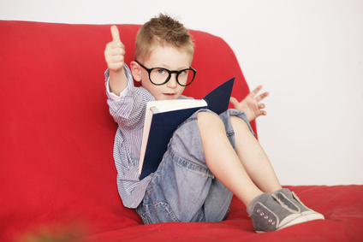
Please listen to your child read for at least 15 – 20 minutes most days.
Reading Practice sessions with the teacher or teaching assistant will take place at least once a week.
The library will soon be up and running. The children can have a non-fiction or picture book (or chapter book from the summer term) for up to two weeks.
We would love to have volunteer parent readers and need a volunteer librarian for our classes. Please indicate this on the sign in sheet.
Notes:
GH

Slide 10
Spelling and Times tables:
In Year 2, we begin by recapping the Phase 5 phonemes and Year 1 spelling objectives from the summer term, as well as learning to spell some curriculum-related words (eg. Numbers).
Spellings will be taught and continuously assessed throughout the week. There will no longer be a spelling test on a Friday.
Parents will still be able to look at their spelling books when they come home on a Friday to see their children’s progress with spelling.
From January, Year 2 children will have fortnightly times tables test this year and any times tables that they need to work on will be recorded in the back on their spelling book that will come home each week.

Slide 11
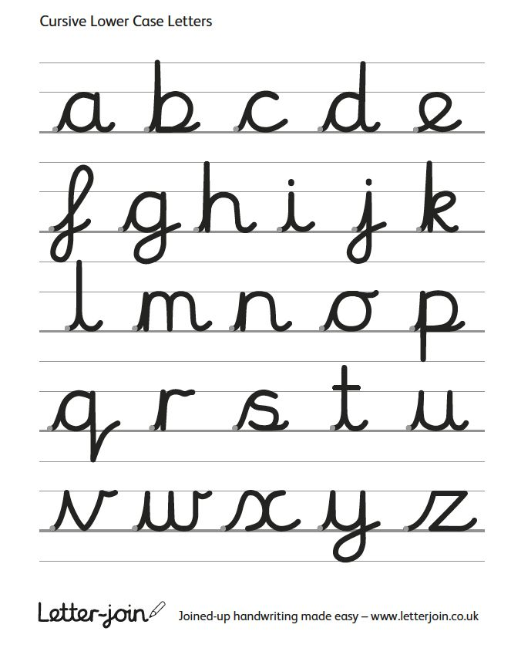
Handwriting
In Year 2, the children are taught to form letters with lead-ins. The joins are not taught until the summer term.
They will use pencil.
Special handwriting pencils and certificates will be awarded to children throughout the year. Please encourage good handwriting practice!
Notes:
GH

Slide 12
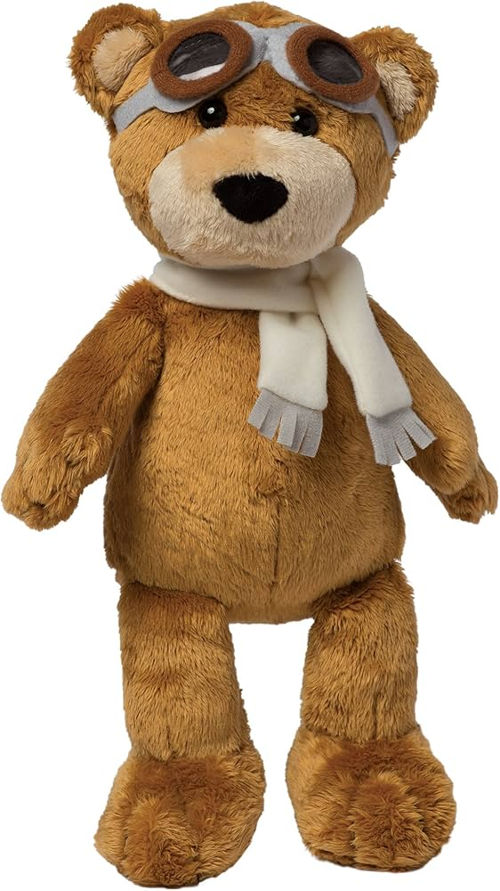
Class writing book
Every Friday, a child in each class will be nominated to take home the class mascot and writing book. They will write out what they have done with the mascot over the week, and share their work the following Friday.
If you take photos and would like these printed, please send them to the office.
This is not assessed work! Children are encouraged to write for the joy of sharing it with their peers. Spelling mistakes will be glossed over!
Notes:
GH

Slide 13
Mathematics
Numbers to 100
Addition and subtraction
2, 5 and 10 times tables
Multiplication and division
Fractions within one whole
Telling the time to 5 minutes on an analogue clock
Using coins and notes to make amounts within £20
Notes:
EL

Slide 14
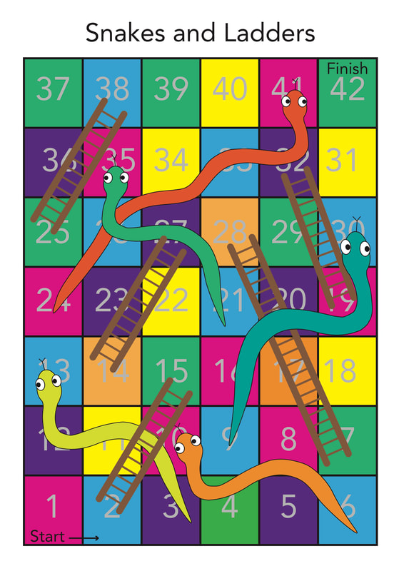
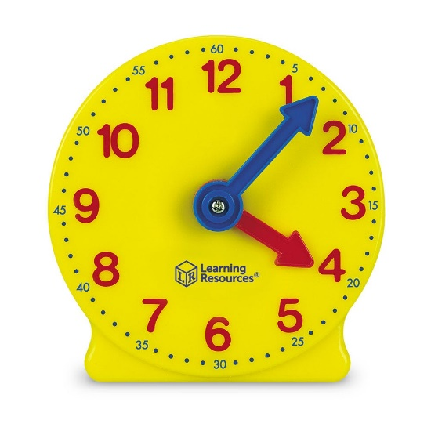
Maths at Home
Play board games such as snakes and ladders.
Play card games such as 21.
Count a selection coins from a money jar and play shops.
Follow recipes and measure ingredients.
Regularly measure the height of all the people and animals in your home.
Practise telling the time using an analogue clock. Start with o’clock, half past, quarter past and quarter to.
Look for repeated patterns both inside and outside of the home.
Notes:
EL

Slide 15
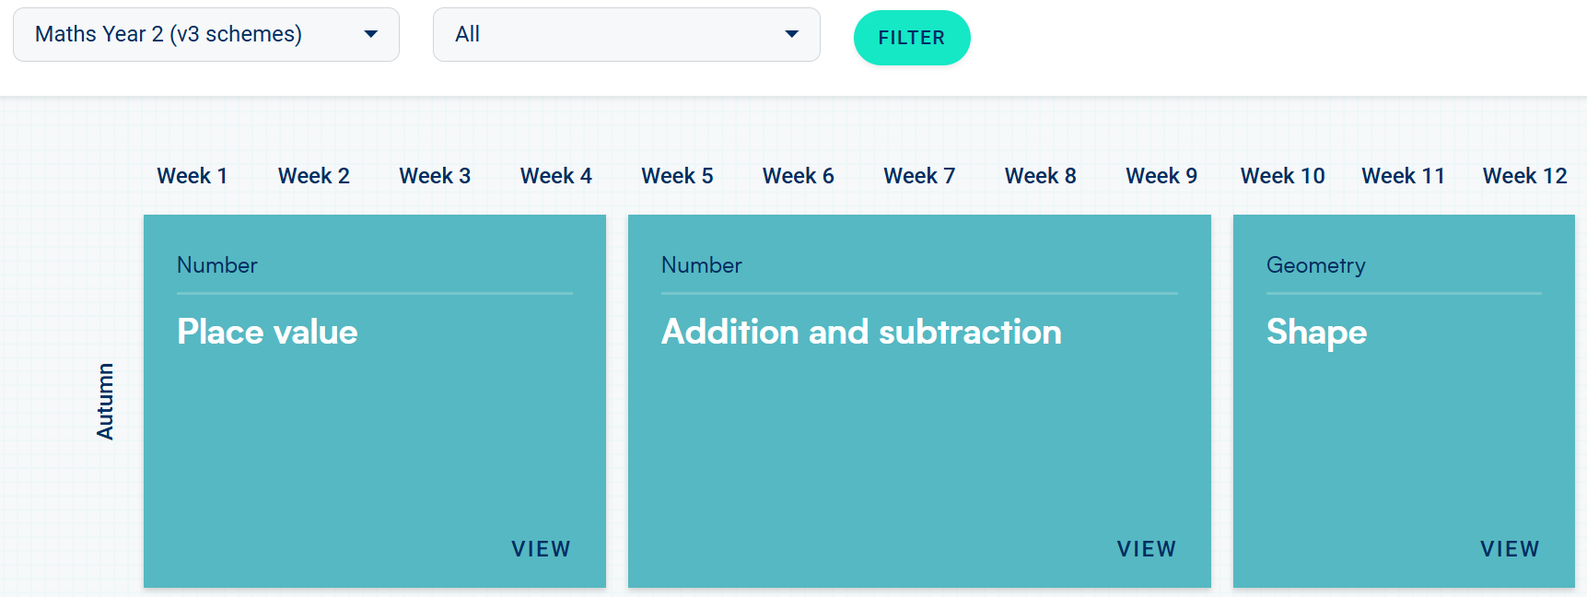
Maths support:
We will set two or three tasks per week on Matheltics linked to the current learning within school.
Children also have access to Numbots, Times Table Rockstars and Purple Mash activities.
For support, see the White Rose home learning videos on the “Parents and pupils” section of their website. https://whiteroseeducation.com/parent-pupil-resources/maths/home-learning?year=year-2-new

Slide 16
Assessment
If your child did not pass their phonics screening check in Year 1, this will be retaken in June after targeted input and assessment throughout the year.
SATS are no longer statutory in Year 2. However, we still administer them in the summer term alongside our teacher assessment. The children will sit two reading papers and arithmetic and mathematical reasoning papers. We refer to these as “special work!”
Notes:
GH
Children might move between phonics groups

Slide 17
Trips and visitors:
29th September: trip to Braintree Museum to visit the Victorian classroom.
18th November: visitor from the Antarctic Survey to talk about visiting Antarctica.
Spring term: trip to The Shuttleworth Museum to see their aeroplane collection.
Summer term: trip to The Challis House Gardens to enrich our learning about plants.
            Bayeux Tapestry Day.
            Year 2 Class assembly.

Slide 18

Who we are
FABS (Friends At Bellbird School) is the PTA at The Bellbird, and is run by a small number of dedicated parent volunteers.
What we do
Last year we have raised over £9,500 from our events, including the Christmas and Summer Fairs, school discos and quiz nights, and we donated over £14,500 to fund the purchase of 32 new Chromebooks to support the delivery of the IT curriculum, provide swimming lessons, a whole school pantomime and paid for a re-stock of the school library and new star reader books.
We need your help!
We are always looking for new parents who want to get involved, please do get in touch on bellbirdpta@gmail.com.

Slide 19
Any questions?
Notes:
NEEDS CHANGING?

Slide 20
Thank you for attending!
We look forward to getting to know you all!

